Slide 1
How we use Cypress with Azure Pipelines
Frode Aarebrot

Slide 2


Slide 3
About me
Packaged Application Development Associate Manager
Notes:
Co-op term with Solvera in 2007
Started full-term with Solvera in 2008, been there ever since
SharePoint, WCF, WinForms, Rest APIs, Middleware services, MVC
Past 5 years -> Full-stack dev -> Angular + .NET Core APIs
Cypress relevant information here

Slide 4
Agenda
##
Make a new pipeline
##
Configure pretty output
##
Publish screenshots + videos
##
Parallel runs
##
Scheduling
Notes:
Configuration
Pipelines
How to make a pipeline
How to make your test output nice and readable
How to publish screenshots and videos from your pipeline runs
How to run tests in parallel in Azure DevOps
How to setup scheduling for your pipeline

Slide 5
Configuration
Five ways of applying your Cypress configuration
Notes:
We’re very briefly going to cover this

Slide 6
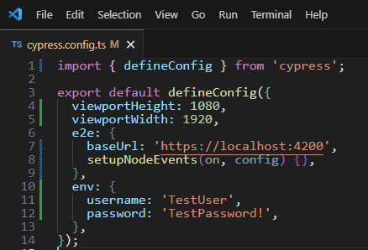
cypress.config.ts

Slide 7
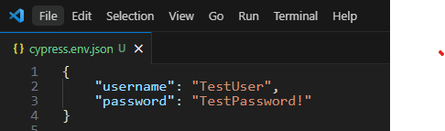
cypress.env.json

Slide 8
Environment variables

Slide 9
CLI

Slide 10
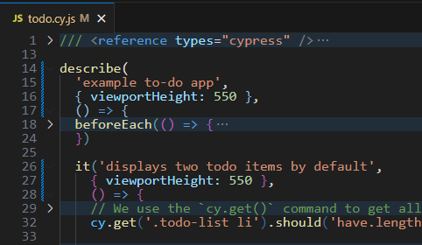
Individual test files

Slide 11
Demo

Slide 12
Demo repo:
https://dev.azure.com/aarebrot/CypressDemo

Slide 13
Wrap up
frode.aarebrot@accenture.com
Notes:
I’ll share this presentation with Darcy, he always puts the slides up on the website after

Slide 14
Thank You

